Slide 1
Campus Storm Shelter Finder
A Demonstration

Slide 2





Team Members
Matthew
Emily
Micah
Wang
Buddy

Slide 3

Objectives
Storm Shelter Location
Distance Finder
Map displaying the location of nearby storm shelters and proximal buildings on campus
Find the distance to nearby storm shelters including walktime
Buttons
Interactive
Buttons located on the map to indicate relevant points
Students can interact with the application for more desirable results.

Slide 4
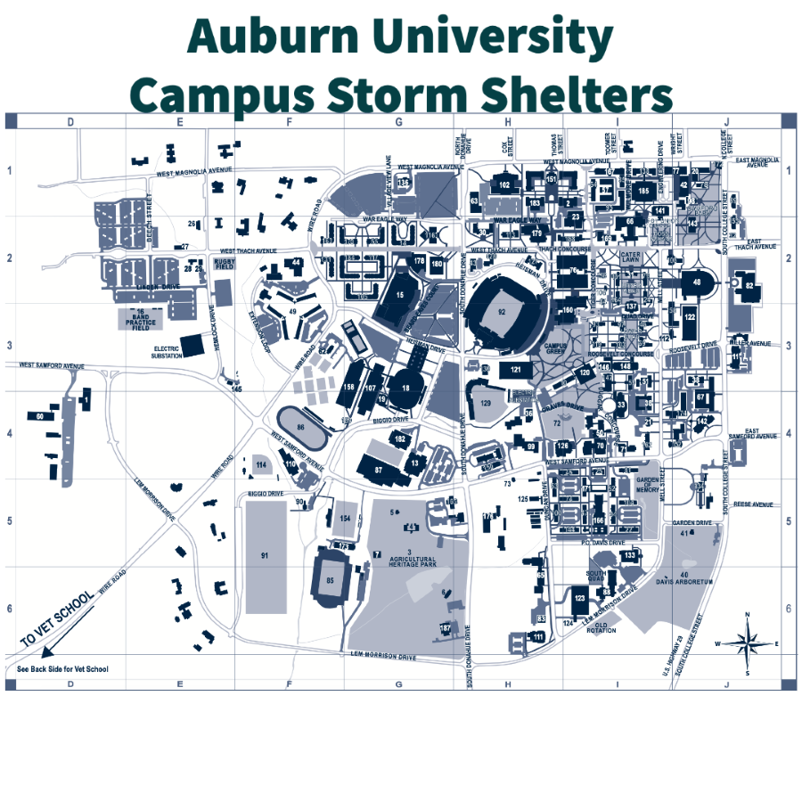
Prototype Map

Slide 5
Our Code
We will display the code here

Slide 7
Summary
With this application we believe that students of all familiarity levels of the campus can be better assisted during times of crisis. The purpose is to effectively show students and staff the concise directions to a storm shelter. We believe that through this application students can make the most optimal choices during the event of a tornado and find the appropriate shelter.

Slide 8
Thank you
Team 5-1​

